Slide 1
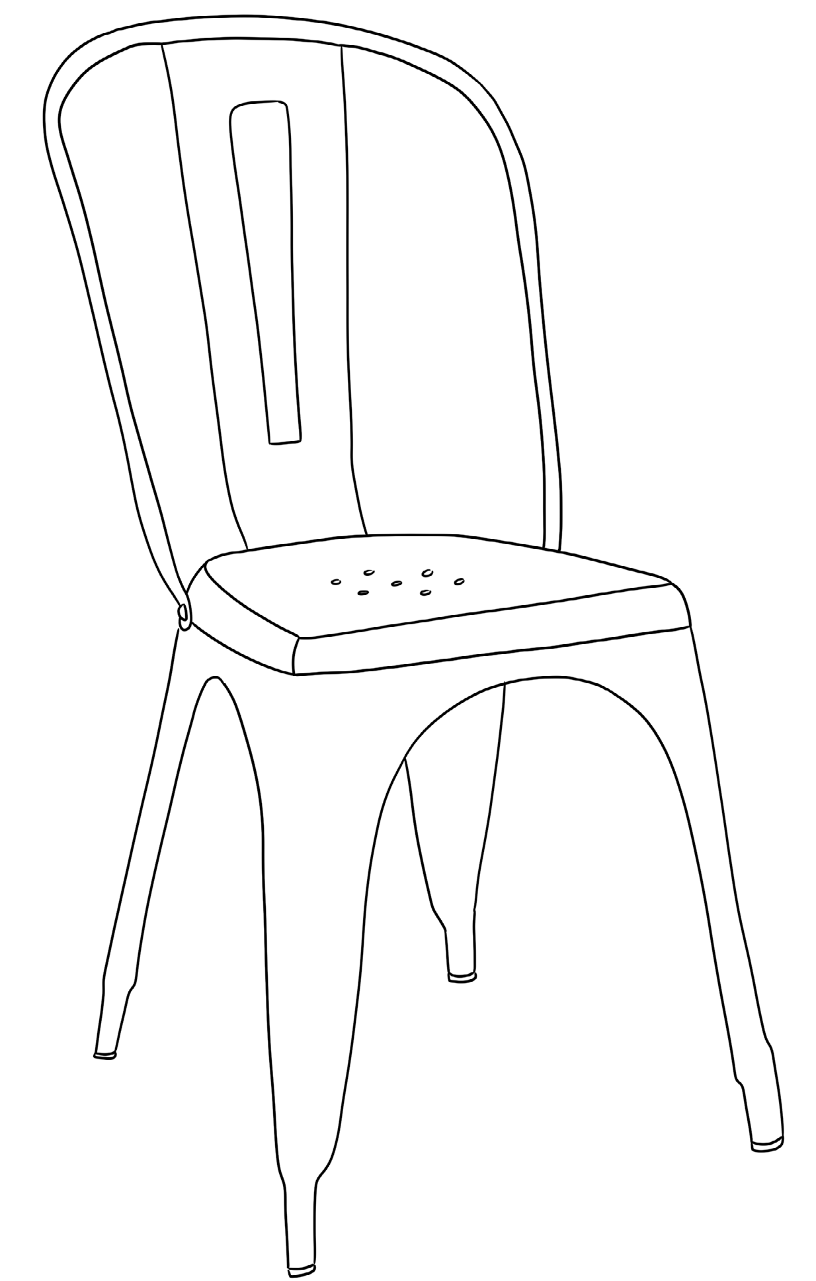
International Congress on Committed and Critical Education
Global Justice, the Teaching Profession, and Transformative Curriculum
University of Barcelona, Catalonia, Spain From January 22 to 24, 2026
TITLE OF THE PRESENTATION
Authorship: Name and surname(s), Institution or organization

Slide 2
GENERAL INSTRUCTIONS
International Congress on Committed and Critical Education
This presentation is prepared to support those who are presenting papers at the Inter-national Congress on Critical and Committed Education 2026.
Adapt it according to your presentation, but make sure to follow the accessibility gui-delines.

Slide 3

GENERAL INSTRUCTIONS
International Congress on Committed and Critical Education
Make sure font sizes are large (at least 24 pt) and easy to read during the presentation.
The default font is Gesta, but if you don’t have access to it, you can use alternatives such as Source Sans Pro, Calibri, or Open Sans.
Avoid underlining and italics, as they can make the text appear crowded. Use bold to emphasize.
Avoid using all capital letters in continuous text. Lowercase letters are easier to read.
Do not move the logo or the background icon; these are fixed elements that must
appear on all slides.

Slide 4
GENERAL INSTRUCTIONS 2
International Congress on Committed and Critical Education
Keep text brief and focus on the key point.
Use sufficient white space.
Avoid using PowerPoint’s built-in animations.
Avoid using action buttons and other default shapes as navigation elements.
Align text to the left, without justification. This makes it easier to find the start and end
of each line and ensures even spacing between words.
Avoid using multiple columns (like in newspapers).
Do not modify the last slide.

Slide 5
USE OF IMAGES
International Congress on Committed and Critical Education
Include alternative text for all visual elements.
In the alternative text, briefly describe the image and mention the presence of any text
and its purpose.
Avoid using text within images as the only method to convey information. If you need to use an image with text, repeat that text in the document.
If using charts, provide alternative text.
Avoid using PowerPoint to demonstrate instructional processes, such as software use, as this may involve numerous shapes and images, each of which would require alterna-tive text.
If you insert videos into the presentation, ensure they are accessible to people with vi-sual or hearing impairments.

Slide 6
USE OF TABLES
International Congress on Committed and Critical Education
Use a simple table structure and specify the information for the column headers.
Ensure that tables do not contain split cells, merged cells, or nested tables.
Avoid completely blank rows or columns.
Add alternative text to the table.

Slide 7
USE OF COLOR
International Congress on Committed and Critical Education
If you want to add color to the presentation (in elements or in the text itself), the Con-gress colors are as follows:
GREEN: #3C876E VIOLET: #7F4469 YELLOW: #A89543

Slide 8
MORE INFORMATION
International Congress on Committed and Critical Education
For more information on accessibility in presentations, you can consult the EERA guide-lines. You can download them in the PowerPoint template available at this link:
https://eera-ecer.de/ecer-annual-conference/faqs-and-advice/accessibility/ how-to-make-your-presentation-accessible

Slide 9


International Congress on Committed and
Critical Education
Global Justice, the Teaching Profession, and Transformative Curriculum

